Slide 1
Watershed and Discharge Station Information
2025/11/05

Slide 2
San Jacinto River Basin, TX

Slide 3
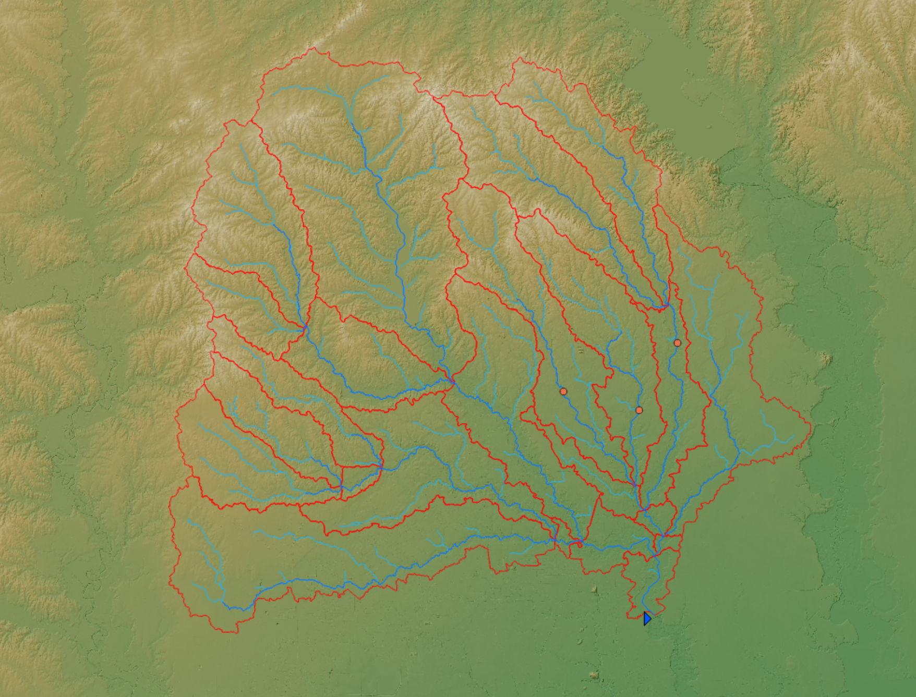
USGS 08070000
USGS 08070500
USGS 08071000
USGS 08072000
(This is not a Discharge Station)

Slide 4
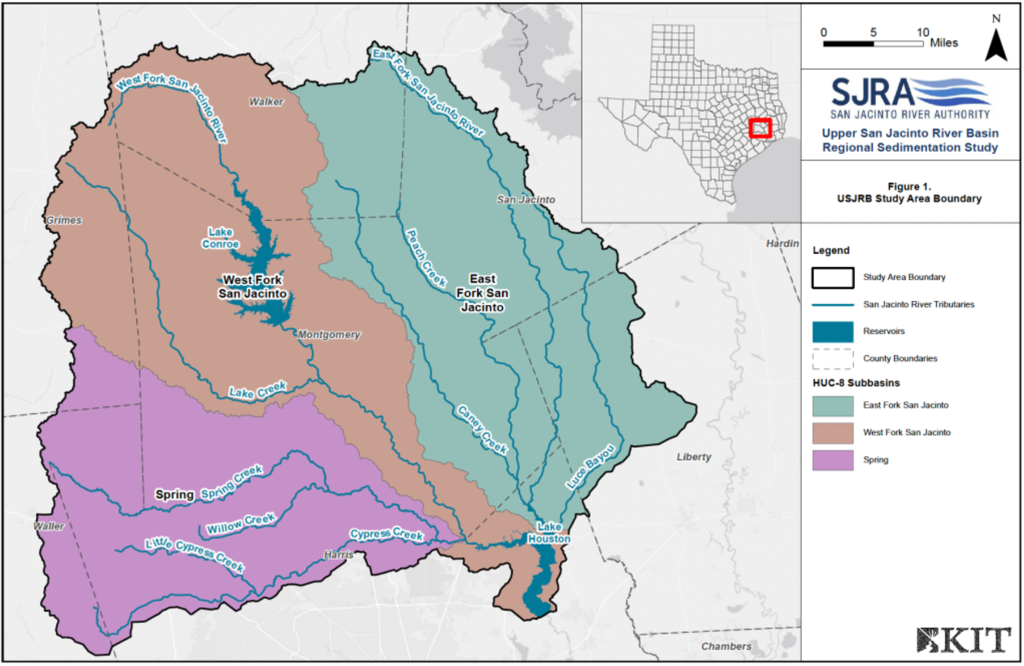

Slide 5
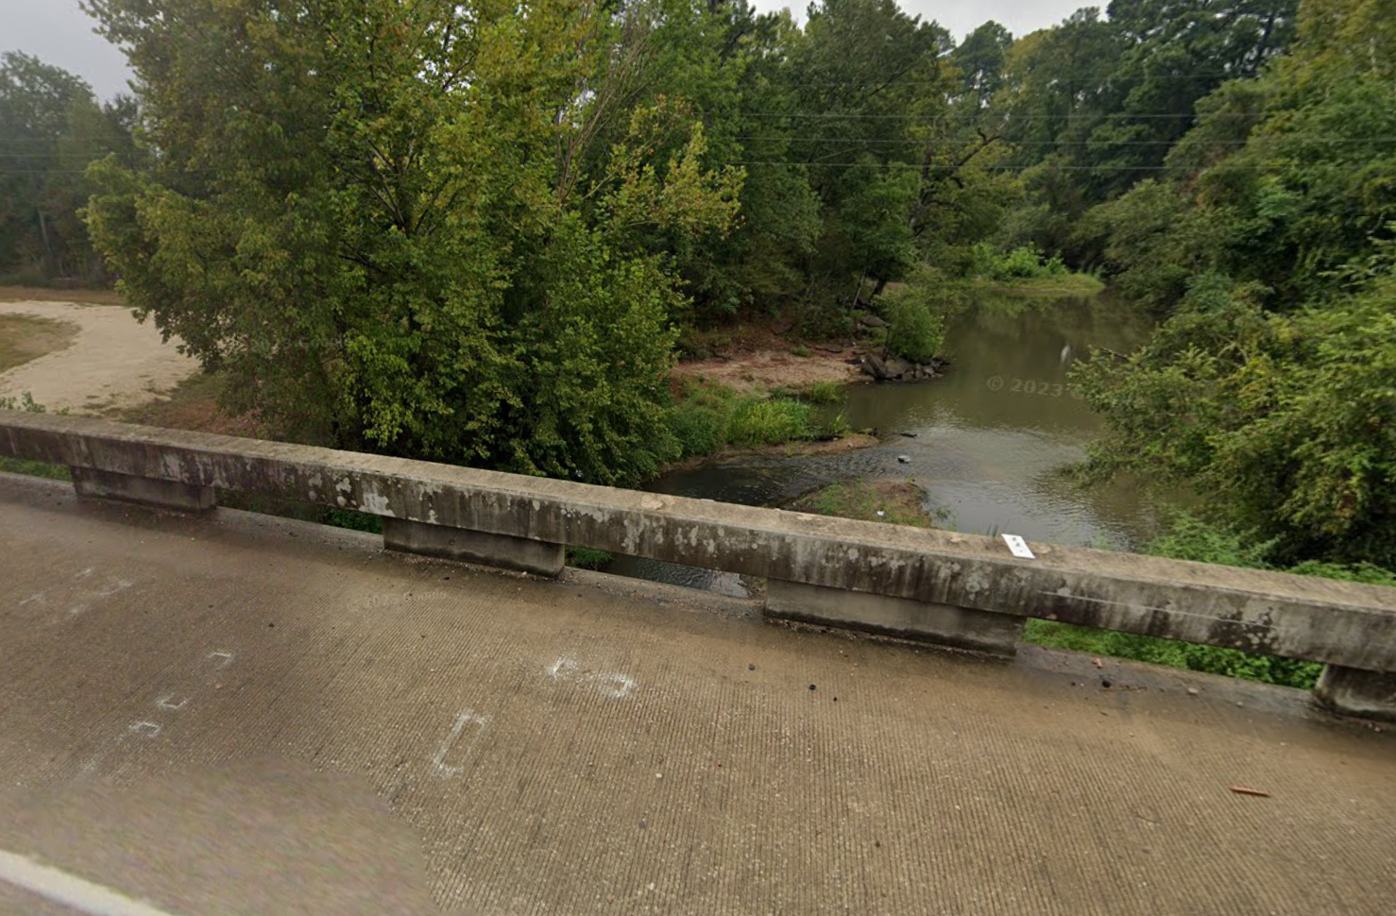
USGS 08070000

Slide 6
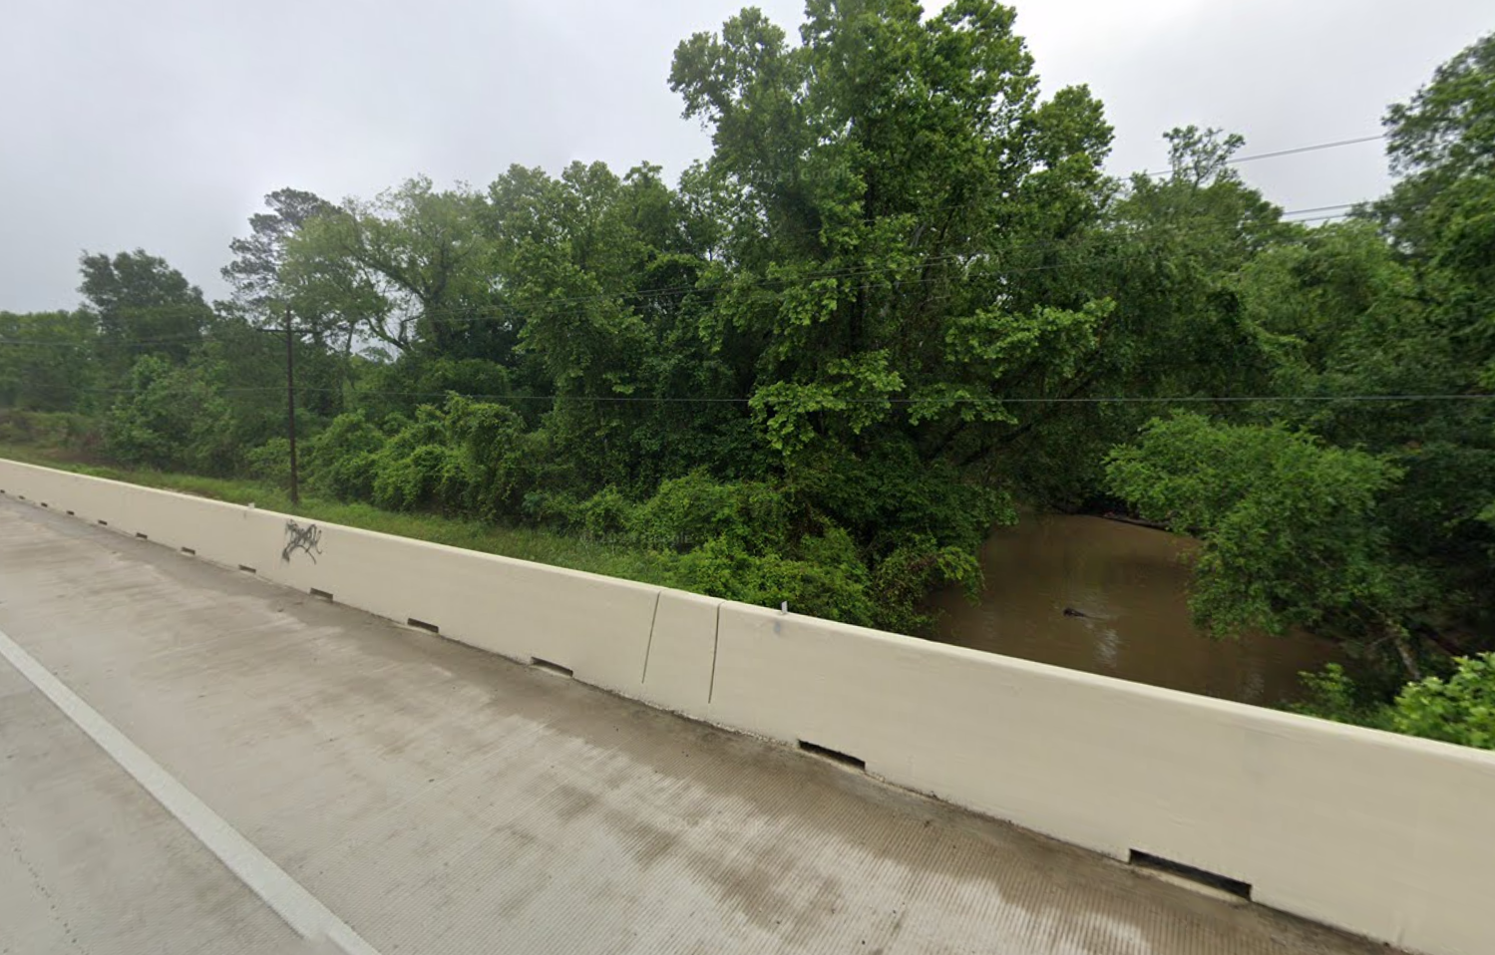
USGS 08070500

Slide 7
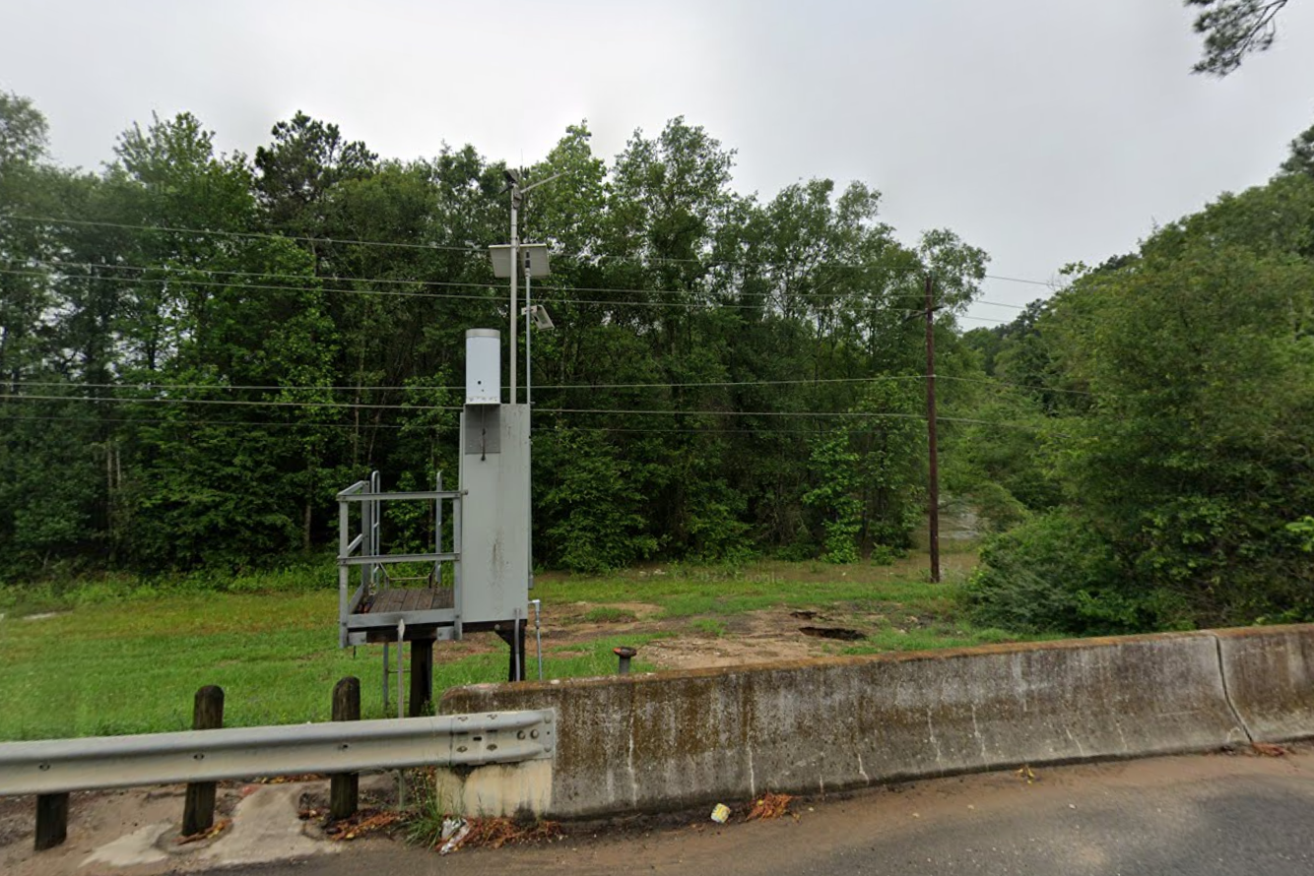
USGS 08071000

Slide 8
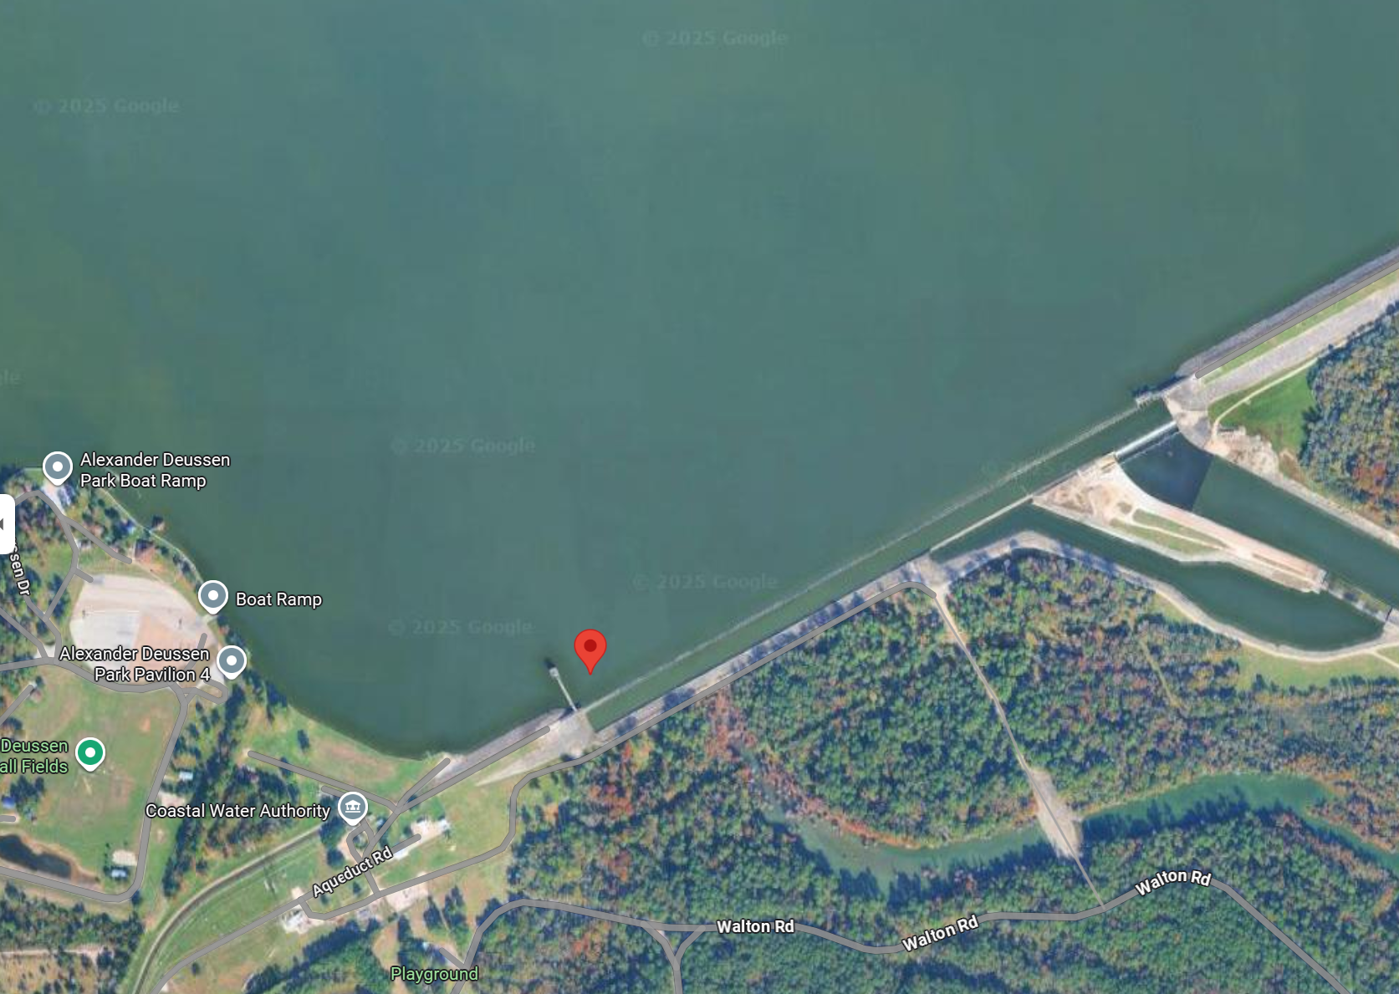
USGS 08072000

Slide 9
San Joquin River Basin, CA

Slide 10
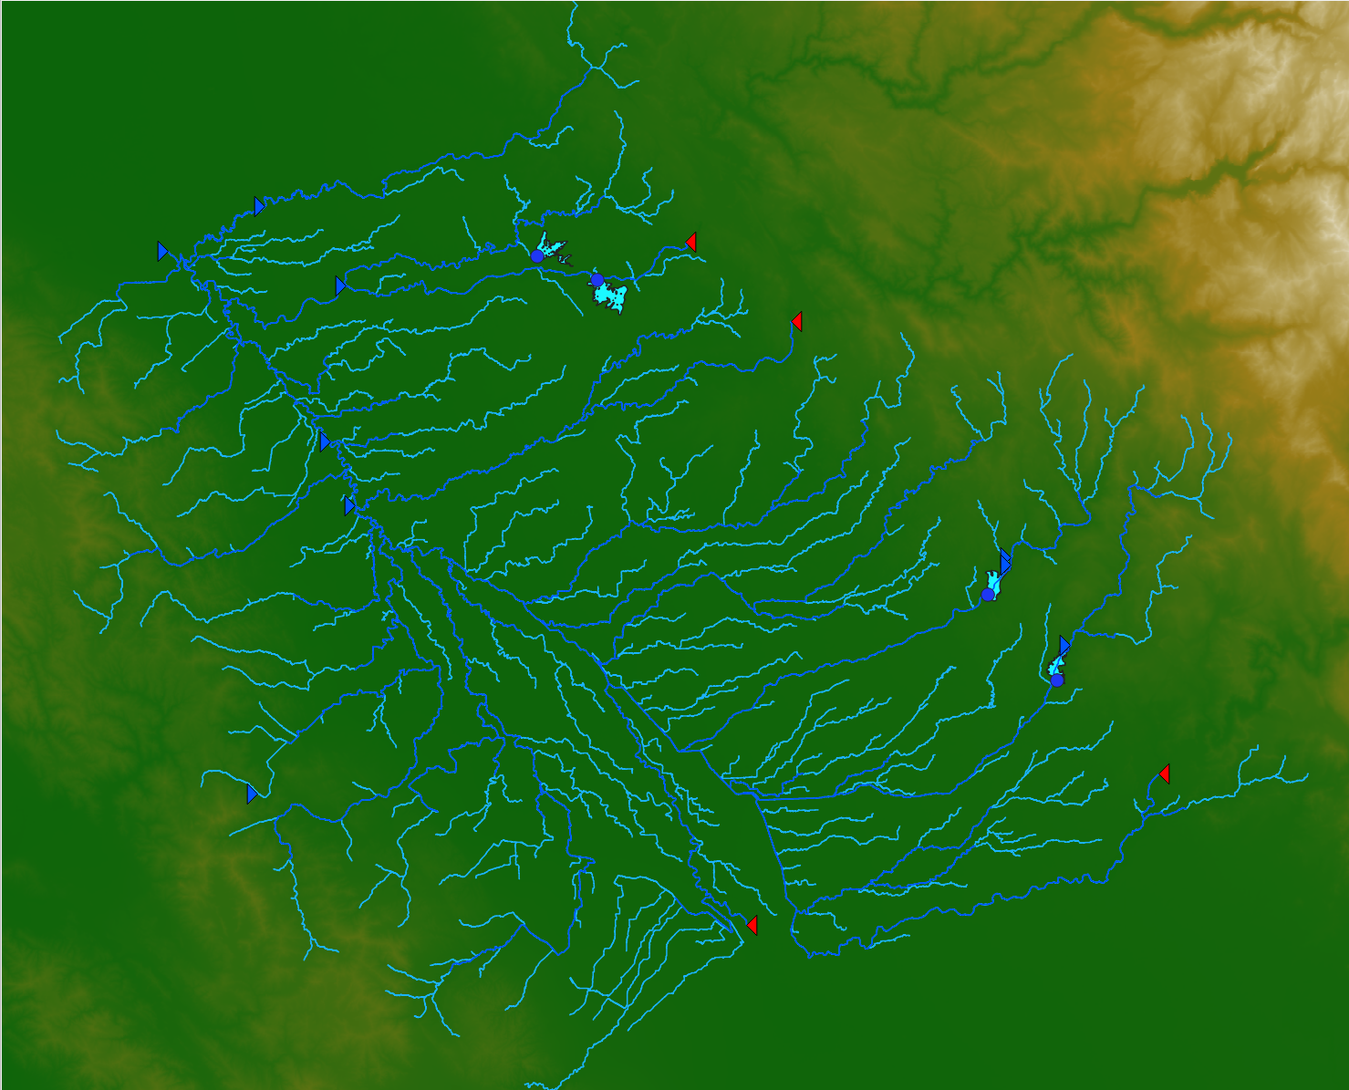
USGS 11303000
1940-10-01 – 2025-09-15
USGS 11289500
1899-07-01 – 2025-09-15
USGS 11303500
1923-10-01 – 2025-09-15
USGS 11290000
1895-01-01 – 2025-09-15
USGS 11270900
1901-04-01 – 2024-09-30
USGS 11274550
1995-10-01 – 2025-09-15
USGS 11274000
1912-05-01 – 2025-09-15
USGS 11251000
1907-10-01 – 2025-09-15
USGS 11254000
1939-10-01 – 2021-12-08

